Slide 1
ONLINE CSE BOOKSTORE
Name: B. Raja Shekhar Reddy
Registration Number: 11908537
Roll Number: A16
Section: KM002

Slide 2
Technologies used:
PHP
CSS
BOOTSTRAP

Slide 3
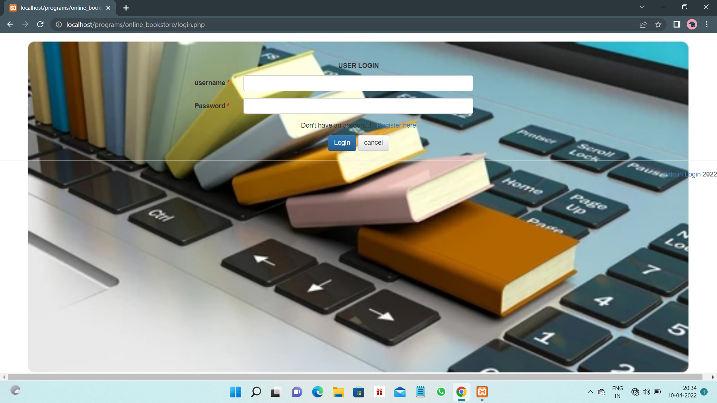
Login page
This is the landing page of the project online cse bookstore.
Here the user can login through his credentials and can get access to the website where he can view and order the desired books.

Slide 4
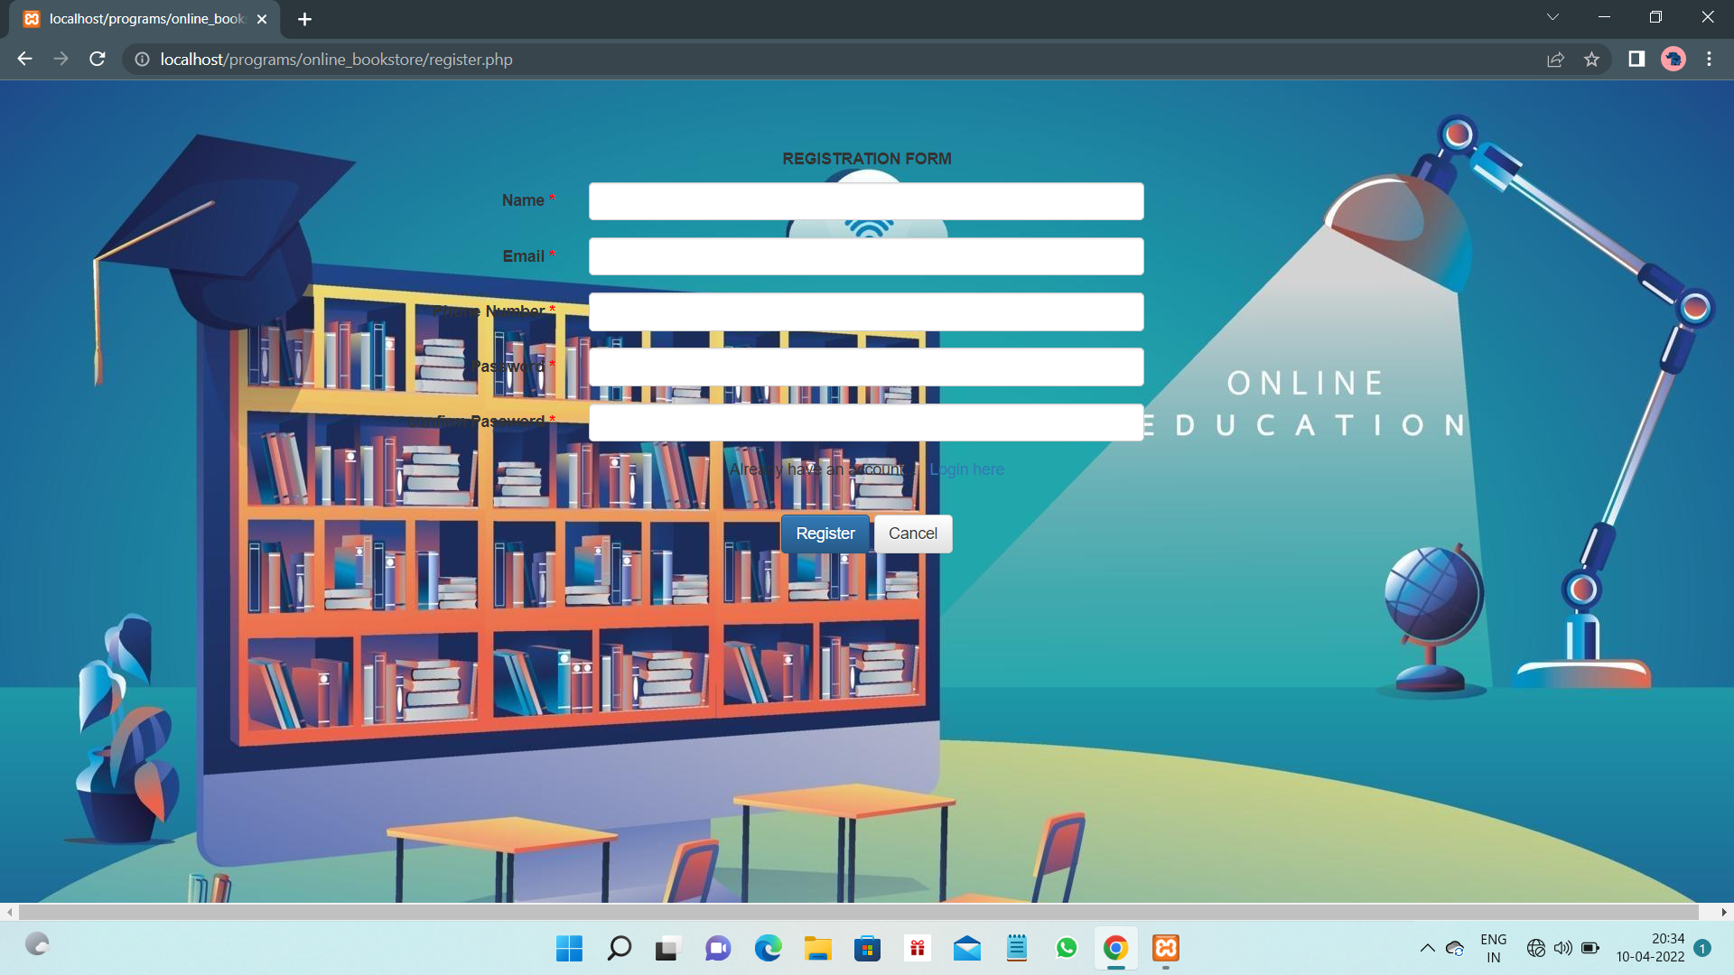
Registration form
This is the registration form for the new user where he can fill his details and go through the login and access the bookstore.

Slide 5
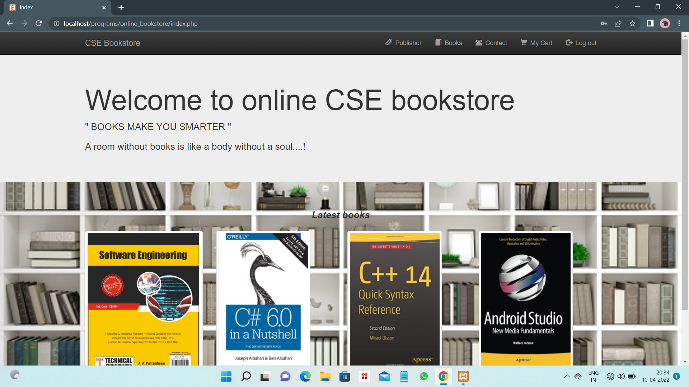
Index page
This is the index page and home page for the online bookstore.
Here We have the latest books added to the store and has columns like books, publishers, contact and my cart in the header of every page.
Also has an Admin login in the footer of every page.

Slide 6
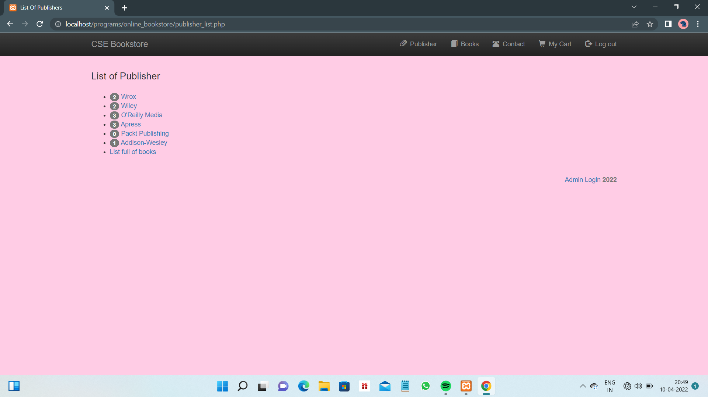
Publisher’s page
In header section, we can see the publisher's icon where we can see the total publishers of the books.
Beside the publisher a number is allocated which represents the total no of books they have published.

Slide 7
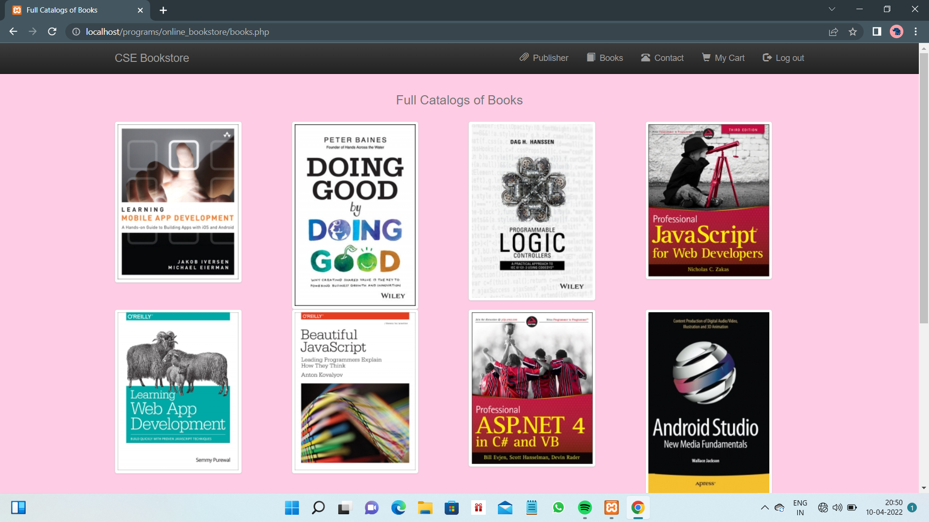
List of the books
In header section, we can check the list of all the books present in the bookstore under books options.
When we click on the selected book a new webpage is opened and there is an option, where the customer can add the book to the cart.

Slide 8
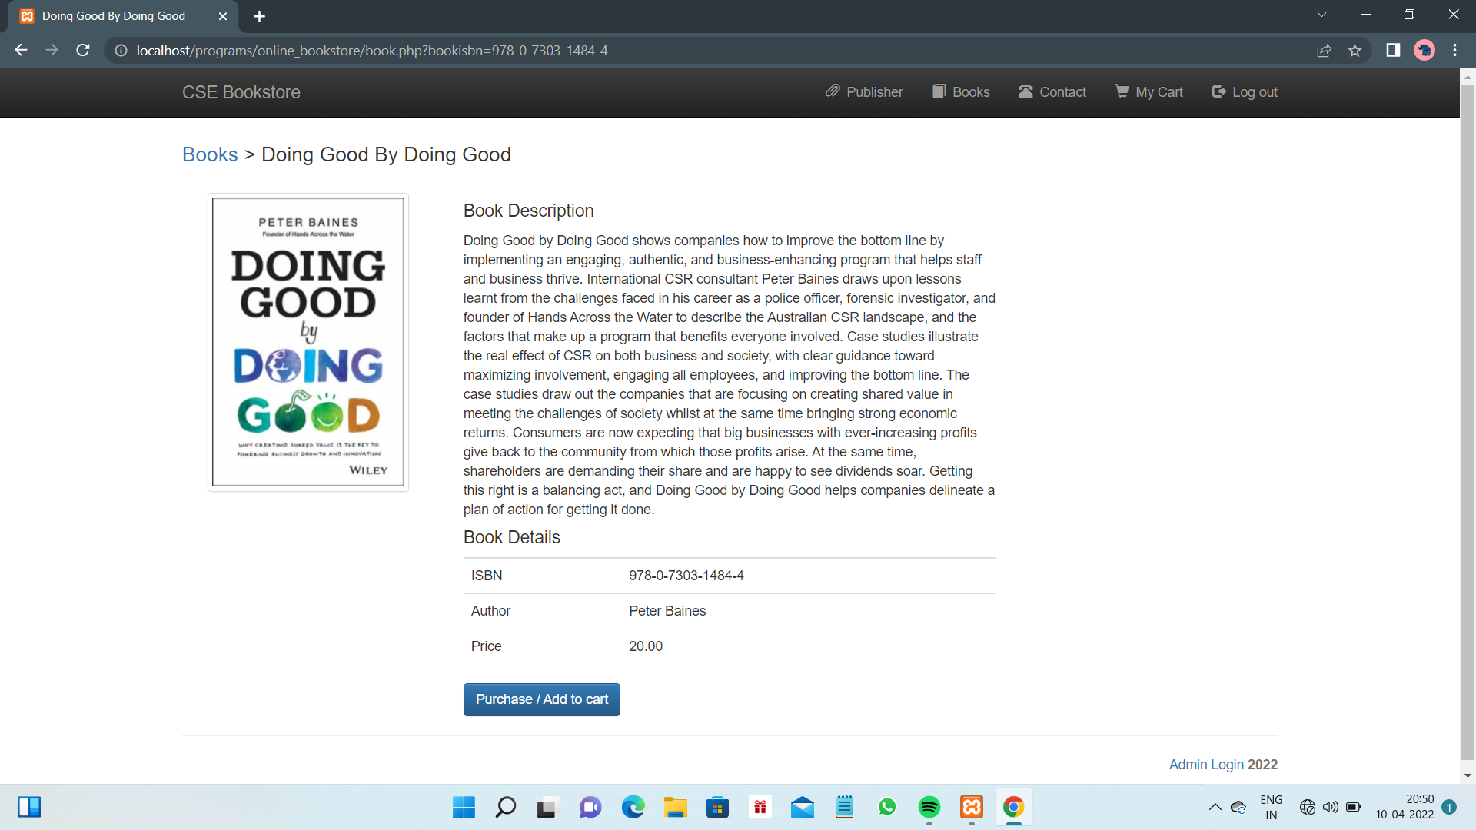
Book details

Slide 9
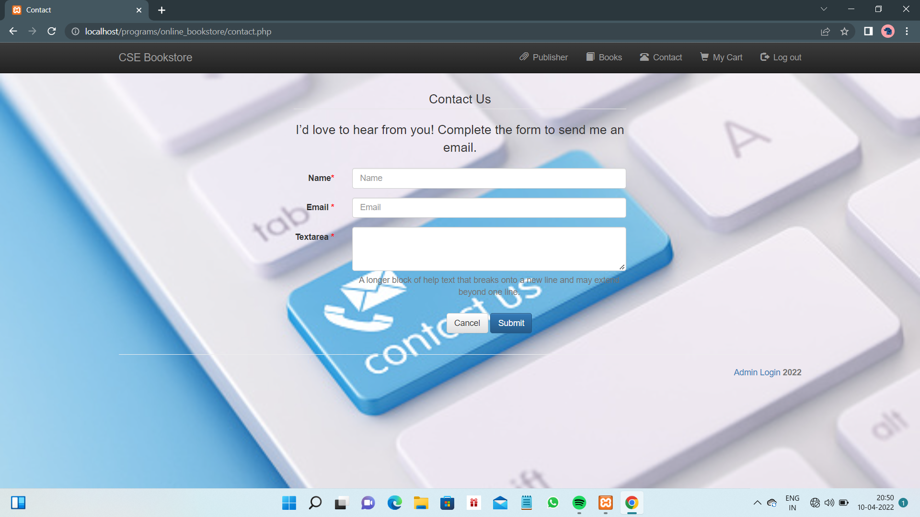
Contact us page
In the same header section, there is an option “contact us”. When customer faces any inconvenience with the website. He/she can contact us, by just mentioning the text in the contact us page with the help of his/her Gmail.

Slide 10
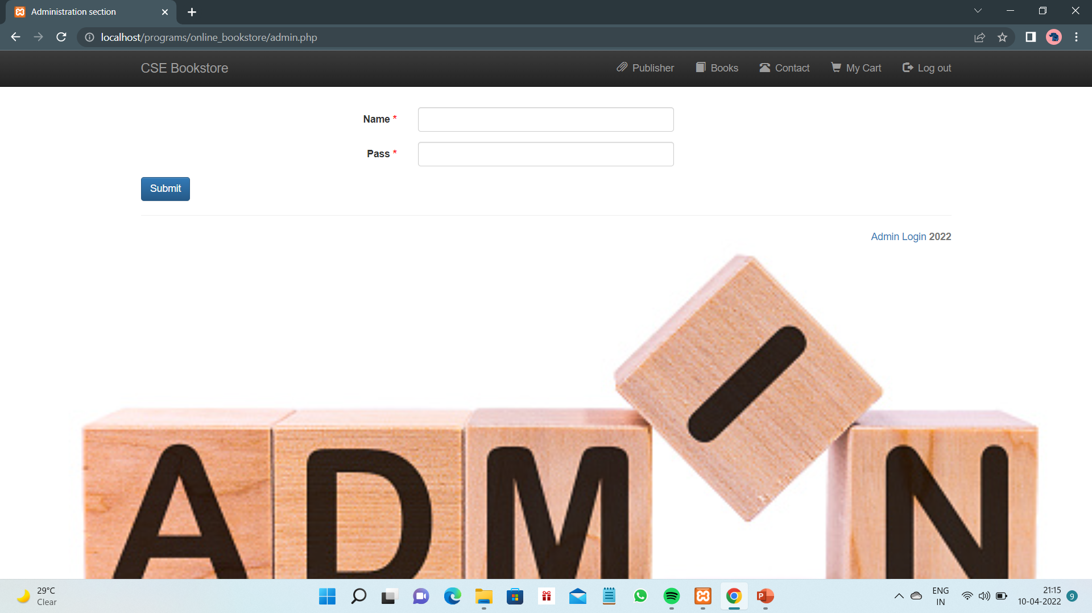
Admin login page
In the footer section, There is an option of admin login when the required credentials are kept, we can see the admin page.
Here the admin can add the new book and able to edit and delete the required book.

Slide 11
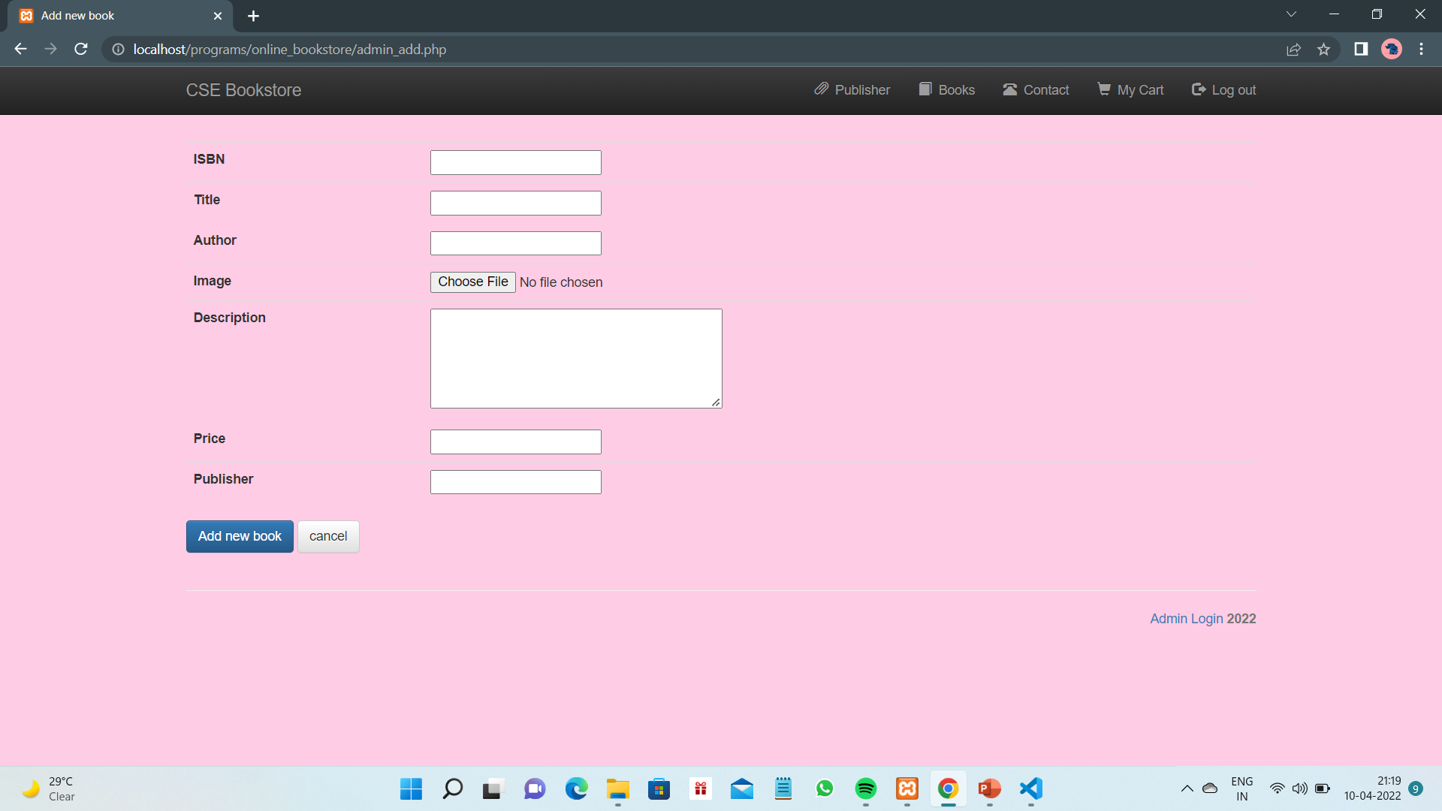
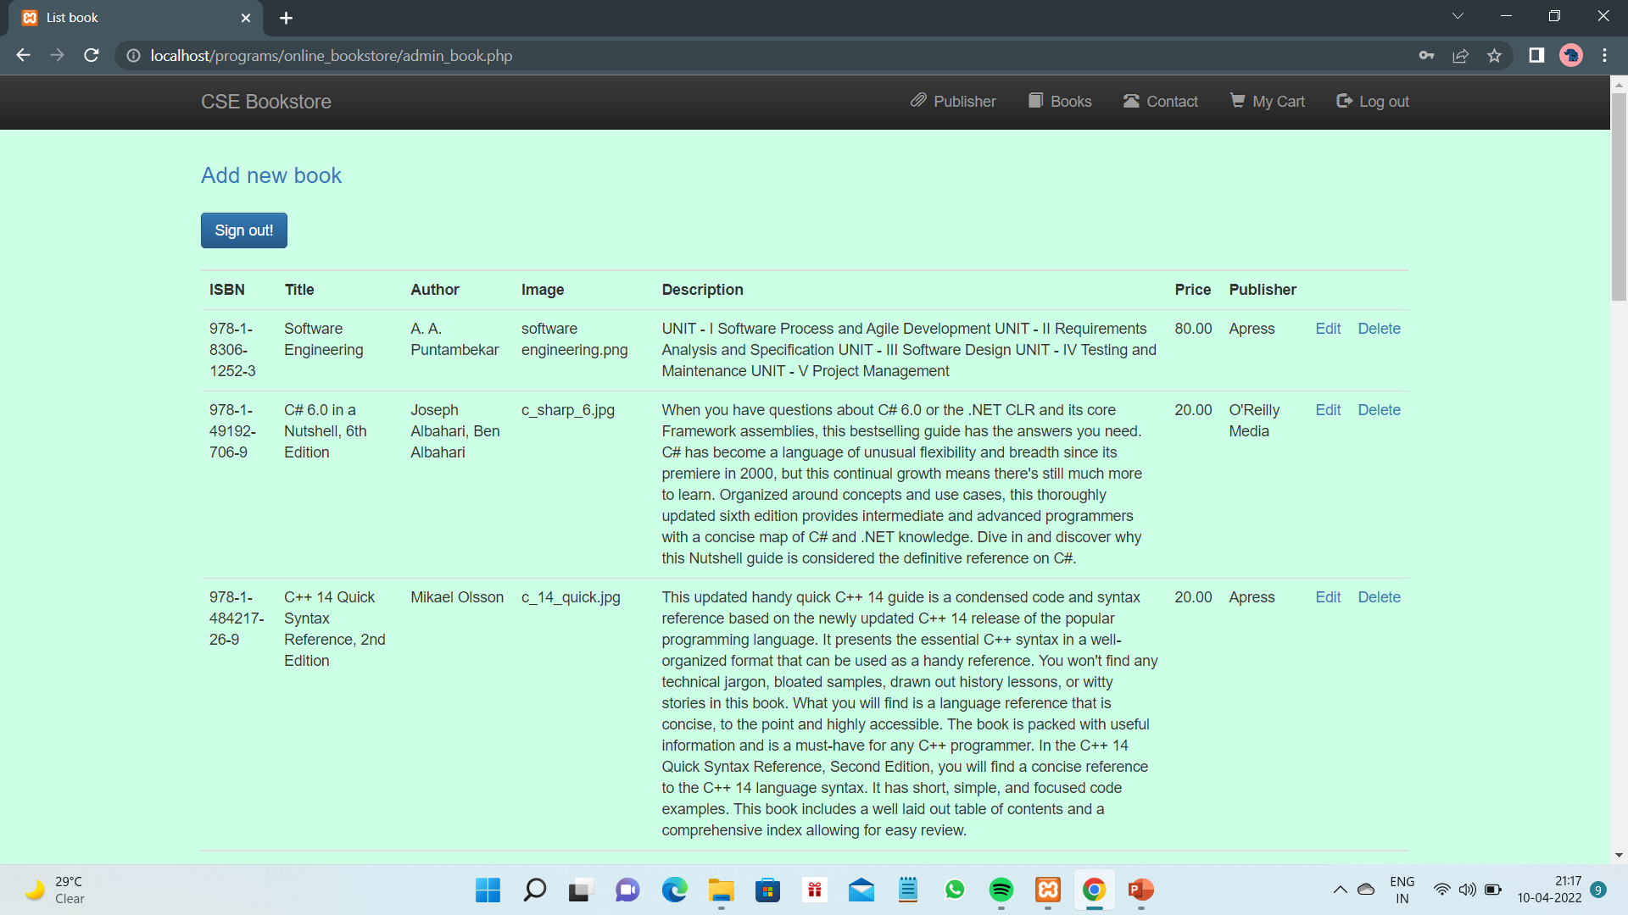
Adding and editing the book

Slide 12
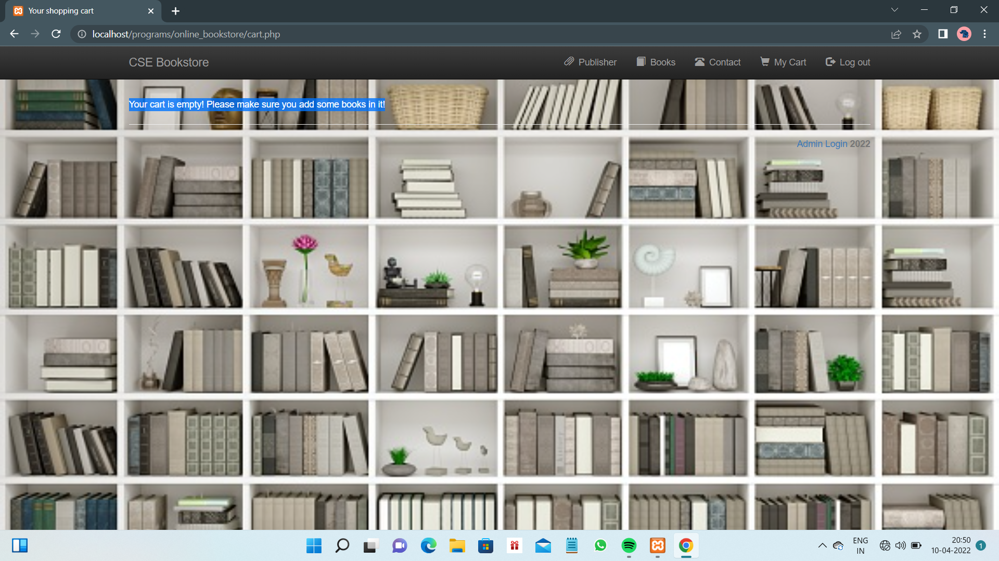
My cart page when empty
At the right corner of this header section, There is an option of “My cart” where the customer can see the books which he/she added the books to the cart.
If the cart is empty, there is a message that “ Your cart is empty! Please make sure you add some books in it”.

Slide 13
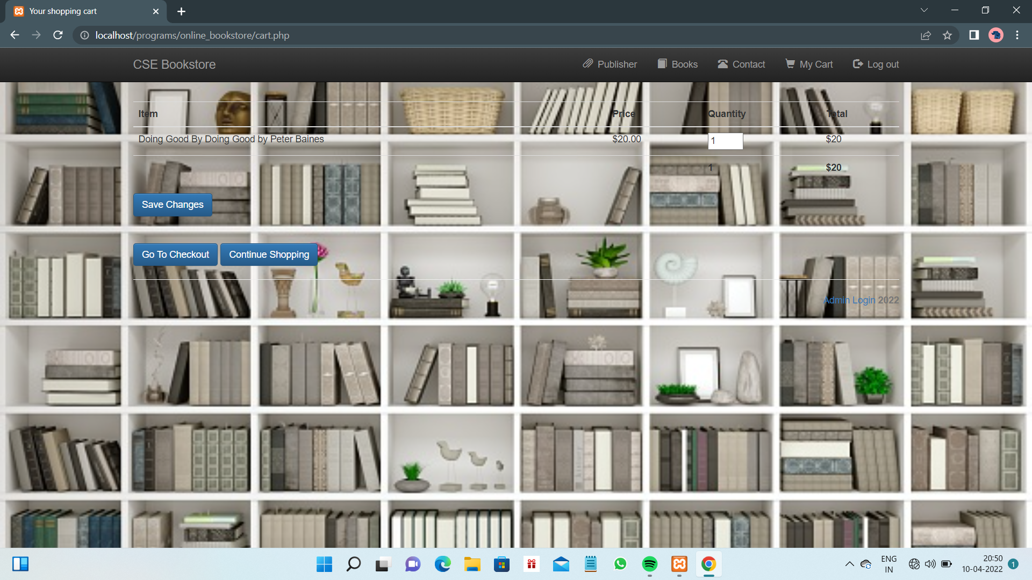
After adding book to the cart

Slide 14
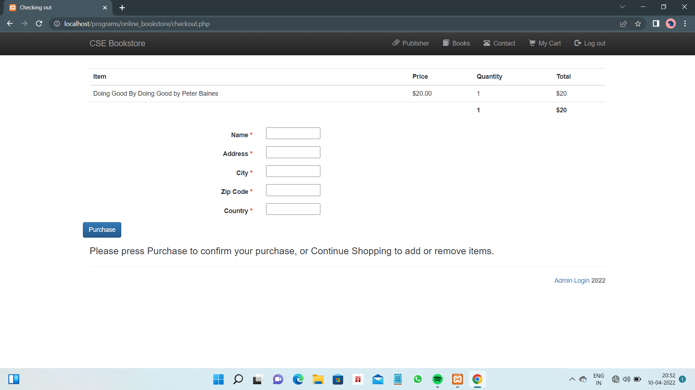
Checkout page
After checkout in the my cart, it will redirect to the purchase page Where the customer need to give information of personal details i.e. Name, address, city, Zip code and country
Here customer can proceed to purchase or can go back to continue the purchases to add or remove books.

Slide 15
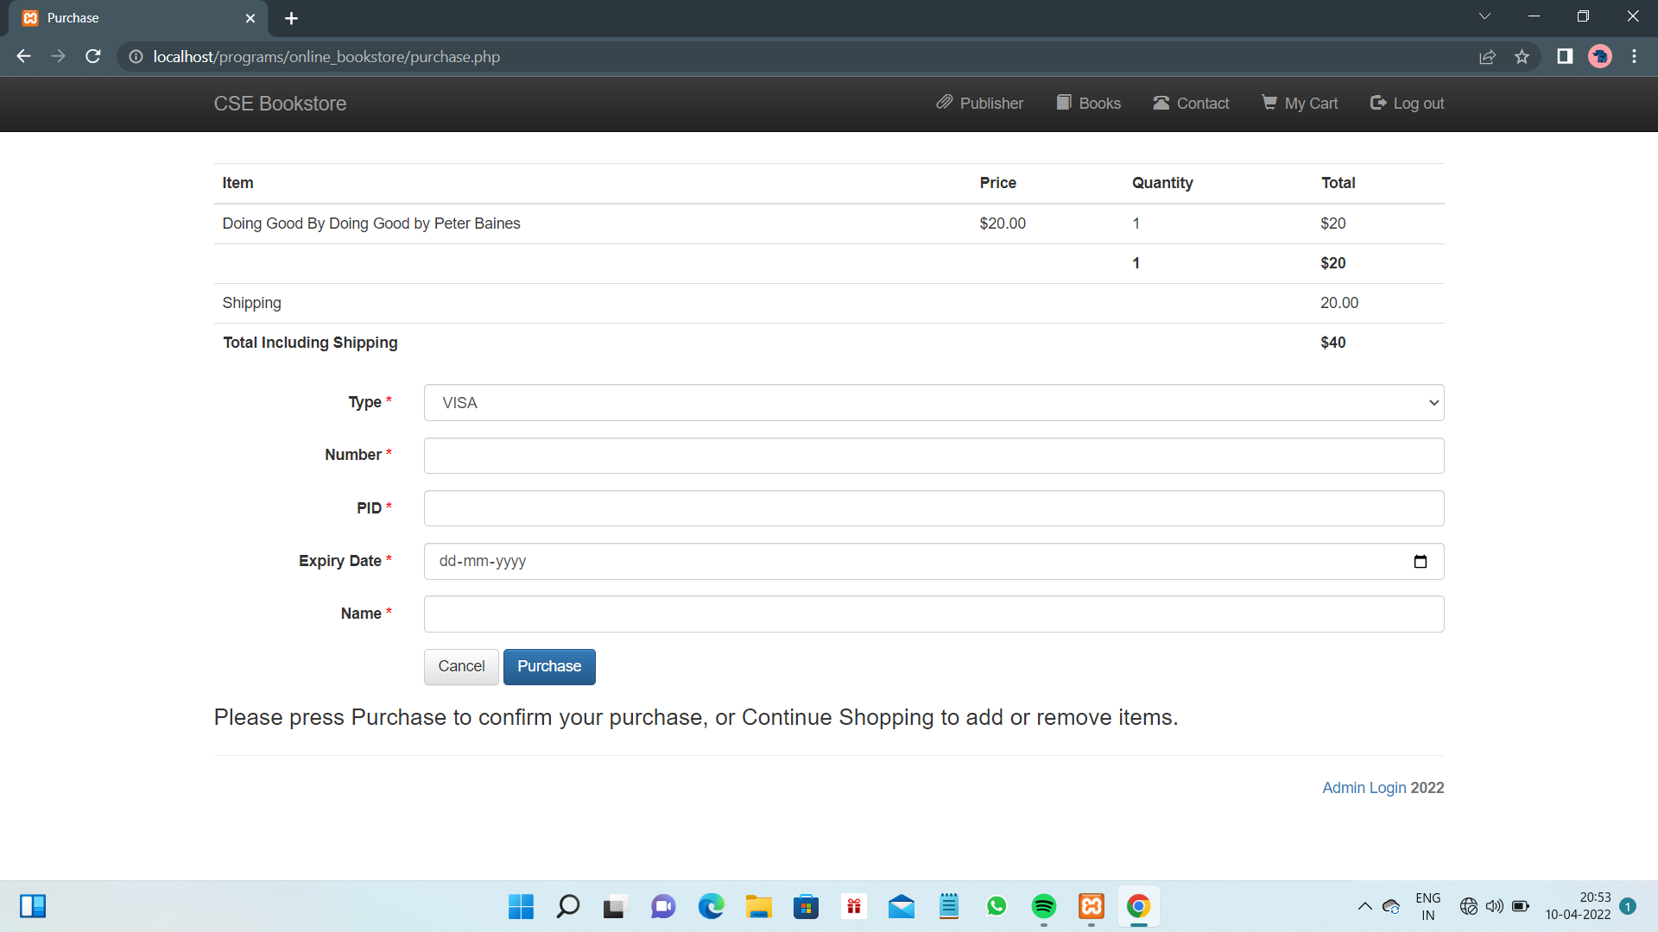
Purchase page
After the customer enters his/her personal details, customer is redirected to the page where he can fill the mode of payment that he can pay the amount required to purchase the books.
Here the customer can see the shipping charges are applied to the total amount he/she need to pay.

Slide 16
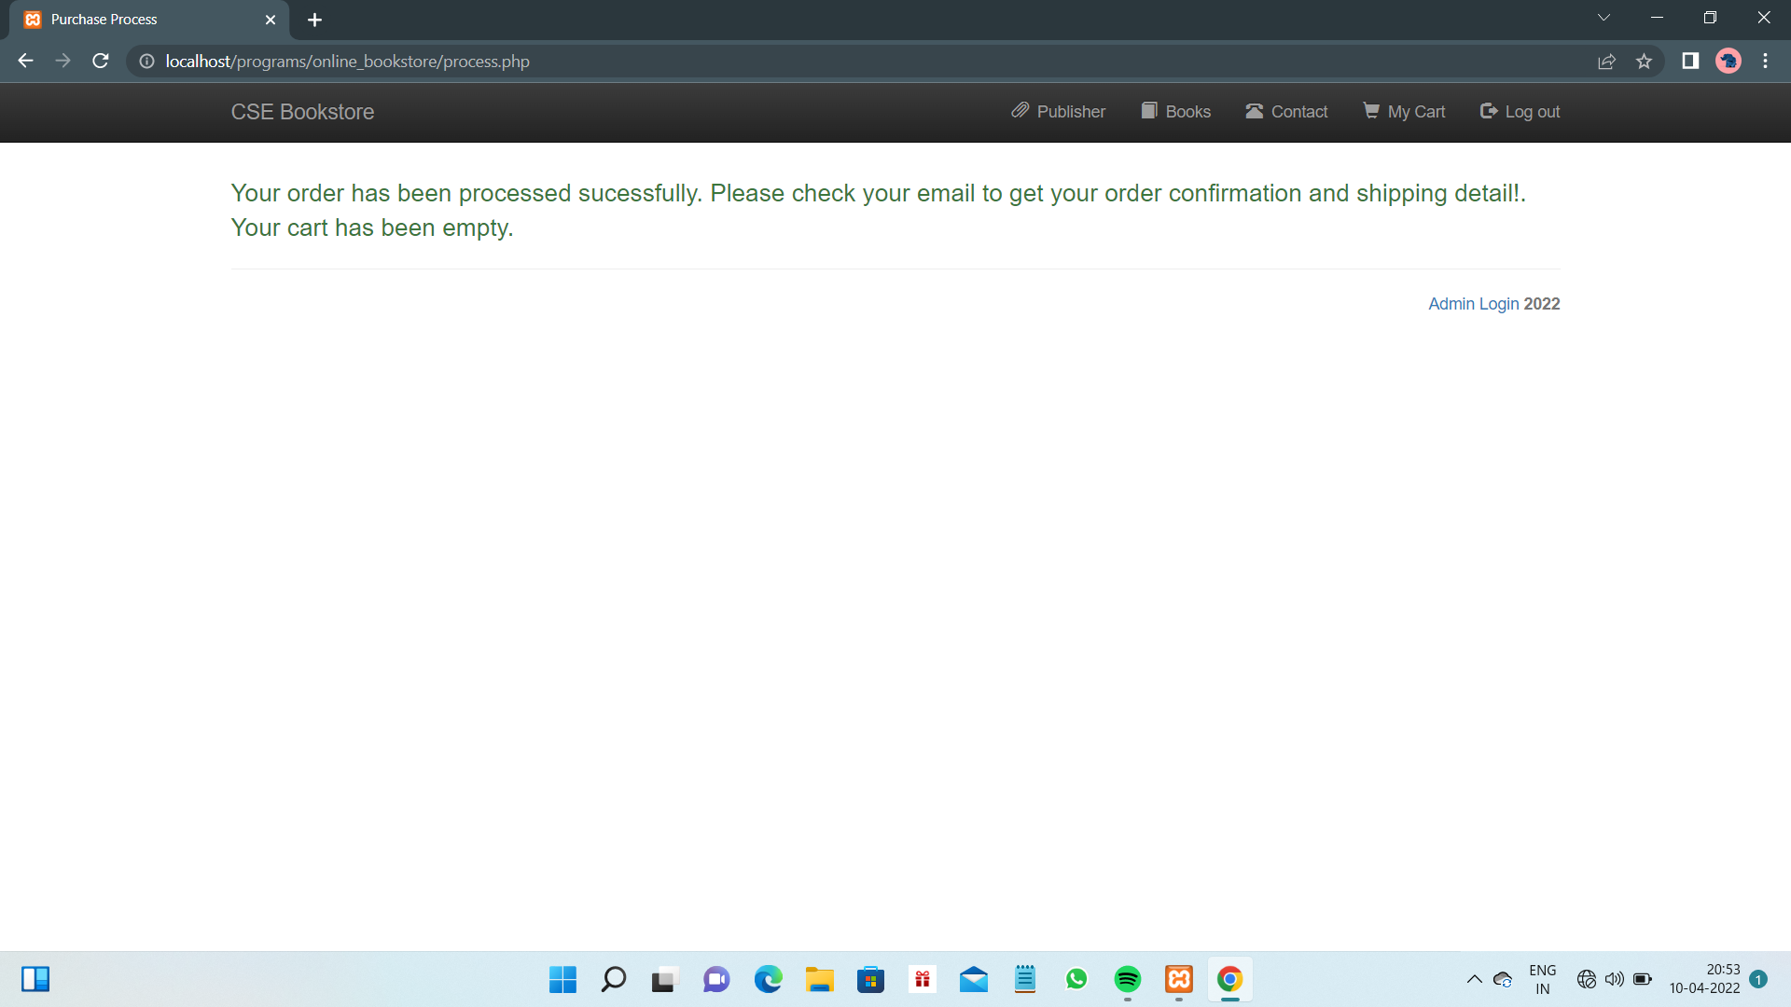
Order placed Successfully
After successfully submitted all the required details and payment, the customer can see the message of ordered successfully placed and the customer can check his mail for confirmation.
Later, the cart has been emptied and the customer can again purchase the book by adding to the cart.

Slide 17
THANK YOU

